Slide 1
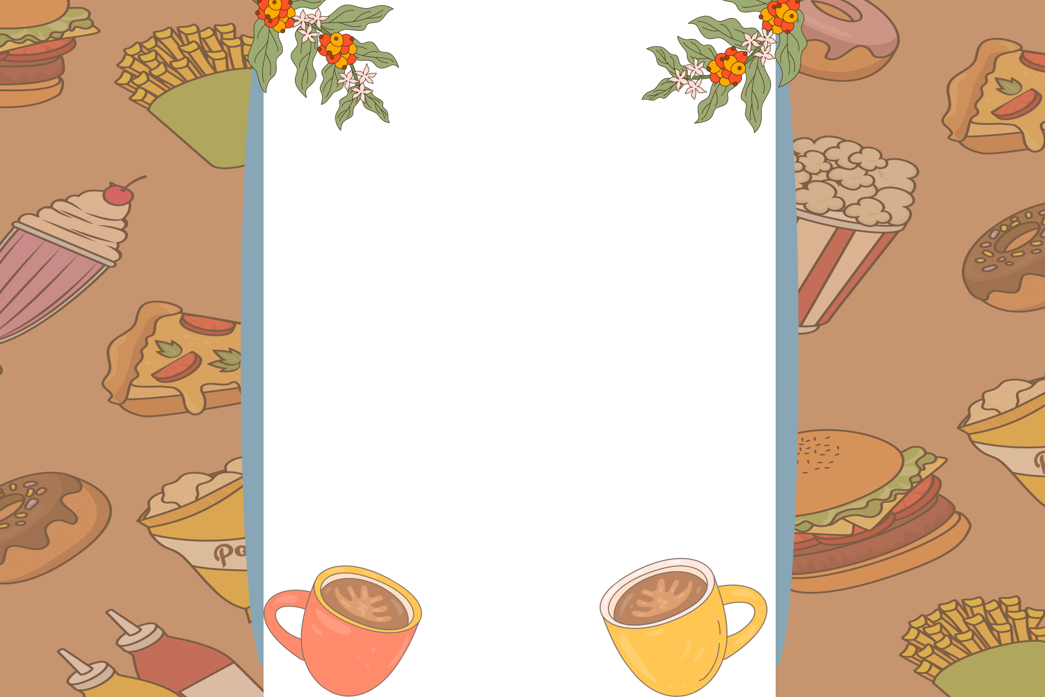
Group 3
HOCHAT
CAFE

Slide 2
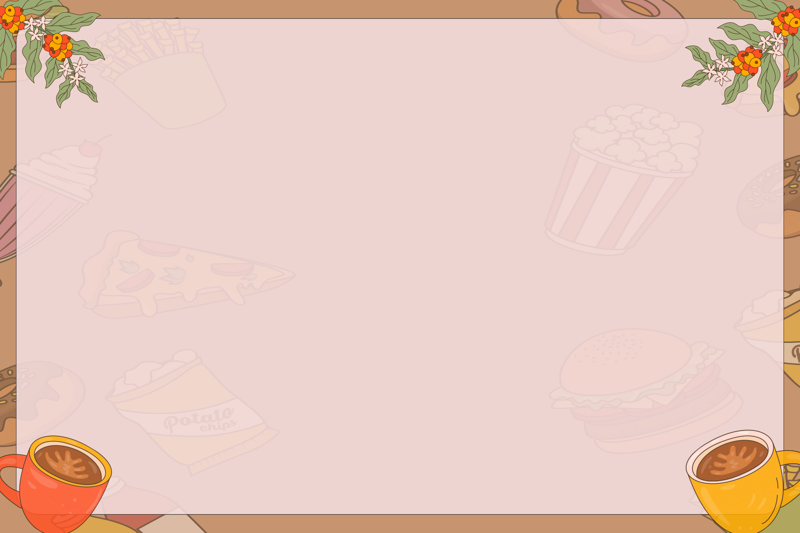
Introduction
Our task was to design and code a café website using HTML and CSS.
The goal was to create a visually appealing, user-friendly, and functional website.
The project showcases navigation, menu presentation, and an ordering feature.

Slide 3
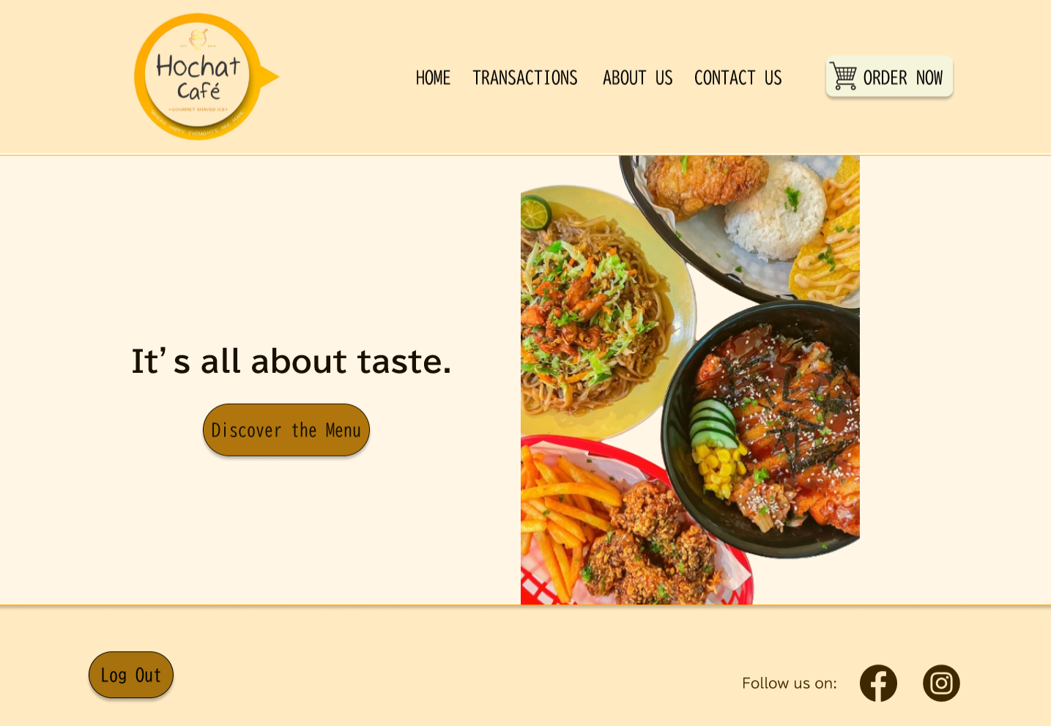
Homepage Overview
Navigation bar: Home, Transactions, About Us, Contact Us, Order Now
Hero section with tagline: 'It’s all about taste.'
Call-to-action button: Discover the Menu
Food images to highlight menu items visually

Slide 4
Main Features
• Easy navigation bar
• Log Out button for user accounts
• Order Now button styled for emphasis
• Social media integration (Facebook & Instagram)
• Clean café-inspired theme design

Slide 5
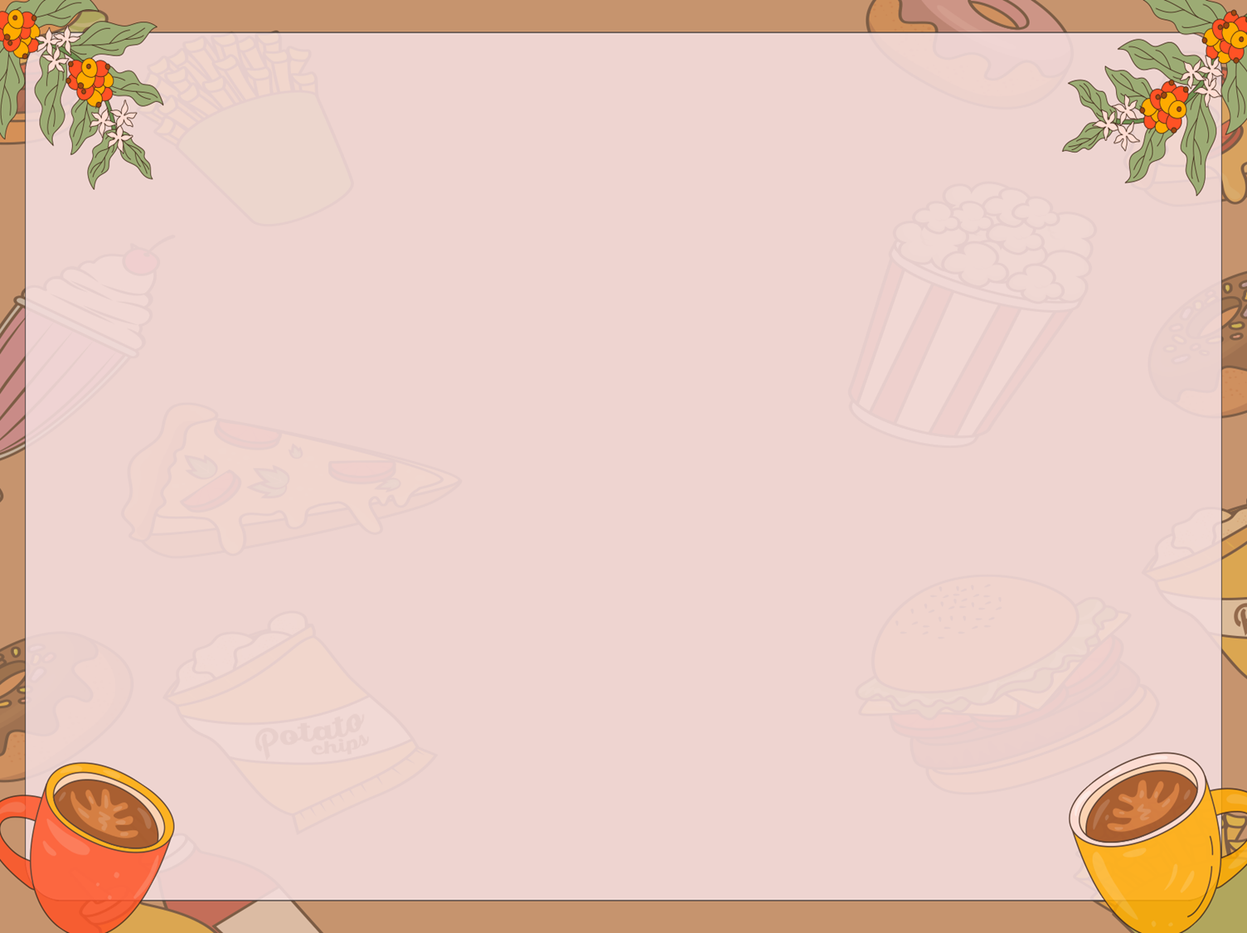
User Experience
• Clear navigation for easy browsing
• Attractive images of food items
• Buttons guide users to menus and orders
• Overall café-inspired aesthetic design

Slide 6
Conclusion
This project allowed us to learn:
HTML for structure
CSS for styling and interactivity
Design thinking for usability

Slide 7

THANK YOU!

